Slide 1

INTELI-REHAB
A Smart Wearable Rehabilitation System
Tehreem Zaheer | CIIT/SP23-BCS-131/ATD
Kashmala Zeb | CIIT/SP23-BSE-048/ATD
Ahmed Irshad | CIIT/SP23-BSE-045/ATD
Supervisor: Dr. Ahmed Khan
Department of Computer Science
COMSATS University Islamabad, Abbottabad Campus

Slide 2
Introduction
Scope (In-scope / Out-of-scope)
Functional Requirements
Non-Functional Requirements
User Goals
Use Cases
Use Case Diagram
Class Diagram
Sequence Diagram
Agenda

Slide 3
Agenda (cont’d)
System Sequence Diagram
Activity Diagram
ER Diagram
Architecture Diagram
Package Diagram
Deployment Diagram
Schedule & Gantt Chart
Iteration Details
Conclusion

Slide 4
Brief Introduction
Inteli-Rehab is a smart wearable rehabilitation platform combining sensor-based movement tracking, EMG muscle analysis, and 3D digital twin visualization.
Wearable armband with dual IMU and dual-channel EMG sensors on a BLE-enabled ESP32 microcontroller.
Flutter mobile app for sensor connectivity, guided exercise sessions, and real-time Digital Twin visualization.
AI-based analysis detects abnormal movement, compensatory behavior, and early fatigue, delivering real-time corrective feedback.
Web dashboard lets physiotherapists monitor progress remotely and lets clinics manage physiotherapist accounts.

Slide 5
Scope
In Scope:
Wearable prototype with dual IMU, dual-channel EMG, and BLE connectivity
Flutter mobile app for device connection, calibration, and exercise management
Joint angle & Range of Motion (ROM) computation using sensor fusion
EMG processing for muscle activity and fatigue monitoring
Real-time 3D digital twin with movement and posture feedback

Slide 6
Scope (cont’d)
In Scope:
AI-based abnormal movement and fatigue detection Gamification (repetition counting, scoring, badges, achievements)
Supabase backend for authentication, cloud storage, and data synchronization
Web dashboards for physiotherapists and clinic administration
Upper-limb rehabilitation under physiotherapist supervision
6

Slide 7
Scope (cont’d)
Out of Scope:
Live video-based pose estimation systems
Clinical diagnostic capabilities beyond exercise guidance
Integration with hospital electronic medical record (EMR) systems
Physics-based biomechanical force simulations
Medical prescriptions or replacement of professional clinical diagnosis

Slide 8
Functional Requirements (1 of 4)
ID | Requirements | Description
FR-01 | Patient Registration & Login | The system shall allow patients to register and log in under an assigned physiotherapist and clinic.
FR-02 | Role-Based Authentication | The system shall authenticate physiotherapists and clinic admins and grant access according to role.
FR-03 | Patient Rehabilitation Profile | The system shall store and manage patient rehabilitation profiles and medical information.
FR-04 | Rehabilitation Exercise Database | The system shall maintain a database of exercises with instructions and clinical guidelines.
FR-05 | Personalized Exercise Plan Management | The system shall let physiotherapists create and manage personalized rehabilitation plans.
7

Slide 9
Functional Requirements (2 of 4)
ID | Requirements | Description
FR-06 | Exercise Plan Version Management | The system shall maintain version history of every rehabilitation exercise plan modification.
FR-07 | Wearable Device Connectivity | The system shall establish and maintain BLE communication with the wearable rehabilitation device.
FR-08 | Sensor Data Acquisition | The system shall continuously collect IMU and EMG data and auto-reconnect after disconnection.
FR-09 | Sensor Calibration & Motion Processing | The system shall guide biometric calibration and estimate joint angles from sensor data.
FR-10 | Rehabilitation Monitoring | The system shall monitor joint angles, repetitions, and ROM in real time during exercises.
8

Slide 10
Functional Requirements (3 of 4)
ID | Requirements | Description
FR-11 | Progress Monitoring & Reporting | The system shall maintain rehabilitation history and generate patient progress reports.
FR-12 | Digital Twin Visualization | The system shall render a real-time 3D digital twin of the patient's arm movement.
FR-13 | AI Movement Assessment | The system shall use AI to detect abnormal movement patterns and compensations.
FR-14 | Corrective Feedback System | The system shall provide real-time visual and voice corrective feedback to patients.
FR-15 | Fatigue Monitoring | The system shall monitor EMG-based muscle fatigue and issue progressive safety alerts.
9

Slide 11
Functional Requirements (4 of 4)
ID | Requirements | Description
FR-16 | Physiotherapist Dashboard | The system shall provide a dashboard for monitoring patient adherence and rehabilitation progress.
FR-17 | Rehabilitation Plan Management | The system shall let physiotherapists prescribe, adjust, and review patient treatment plans.
FR-18 | Clinic Administration | The system shall provide a panel for managing physiotherapist accounts within a clinic.
FR-19 | Cloud Synchronization & Notifications | The system shall sync rehabilitation data to the cloud and notify physiotherapists of key events.
10

Slide 12
Non-Functional Requirements
Usability Requirements:
  Intuitive mobile and web interface; patient starts a session within 3 interactions
  Clear visual indicators and color-coded feedback for exercise status and Digital Twin
  Real-time visual and voice guidance during exercises
  Physiotherapist dashboard shows easy-to-understand charts and reports

Slide 13
Non-Functional Requirments (cont’d)
Performance Requirements:
  BLE connection established with the wearable within 5 seconds
  AI module detects incorrect posture and abnormalities within 3 second
  Dashboard loads patient history within 3 seconds for up to 100 sessions
  Backend responds to standard API requests within 2 seconds

Slide 14
Non-Functional Requirements (cont’d)
Reliability & Availability:
  99% system availability during normal operation
  Automatic BLE reconnection without terminating the rehabilitation session
  Session data stored reliably to prevent loss during failures

Slide 15
Non-Functional Requirements (cont’d)
Security Requirements:
  Role-Based Access Control for Patient, Physiotherapist, and Clinic Admin
  User passwords securely hashed before storage

Slide 16
Non-Functional Requirements (cont’d)
Scalability Requirements:
  Supports additional clinics, physiotherapists, and patients without major changes
  Cloud database uses optimized indexing for growing rehabilitation records
  Supports concurrent rehabilitation sessions without performance degradation
  Architecture supports future wearable sensors and rehabilitation modules

Slide 17
Non-Functional Requirements (cont’d)
Maintainability Requirements:
  Modular architecture allows independent updates to each system layer
  Supports unit and integration testing for verification
  Git-based version control ensures traceability of updates and fixes

Slide 18
Non-Functional Requirements (cont’d)
Portability Requirements:
  Mobile application supports Android 10 (API 29) or later
  Web dashboard compatible with Chrome, Edge, Firefox, and Safari
  Backend services support deployment on Windows and Linux

Slide 19
User Goals
Track rehabilitation progress accurately using wearable sensors
Receive real-time corrective feedback during exercises
Reduce manual effort in monitoring patient recovery
Visualize movement quality through an interactive Digital Twin
Stay motivated through gamified progress tracking
Enable physiotherapists to remotely monitor and adjust treatment plans
Streamline clinic management of physiotherapist accounts
1

Slide 20
Use Cases
UC-1: Register/Login
UC-2: Select Clinic
UC-3: Select Physiotherapist
UC-4: Connect Wearable Device
UC-5: Calibrate Sensors
UC-6: View Assigned Exercise Plan
UC-7: Start Rehabilitation Session
UC-8: Perform Exercise
UC-9: View Live Digital Twin
UC-10: Receive Real-Time Feedback

Slide 21
Use Cases (cont’d)
UC-11: View Progress
UC-12: Manage Exercise Database
UC-13: Assign Exercise Sessions
UC-14: Set ROM Targets
UC-15: Review Session History
UC-16: Modify Exercise Plan
UC-17: Add Physiotherapist
UC-18: Remove Physiotherapist
UC-19: Manage Physiotherapist Accounts

Slide 22
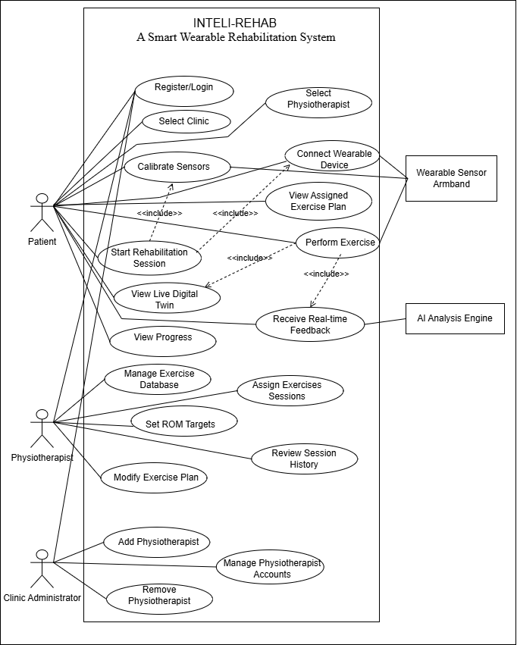
Use Case Diagram

Slide 23
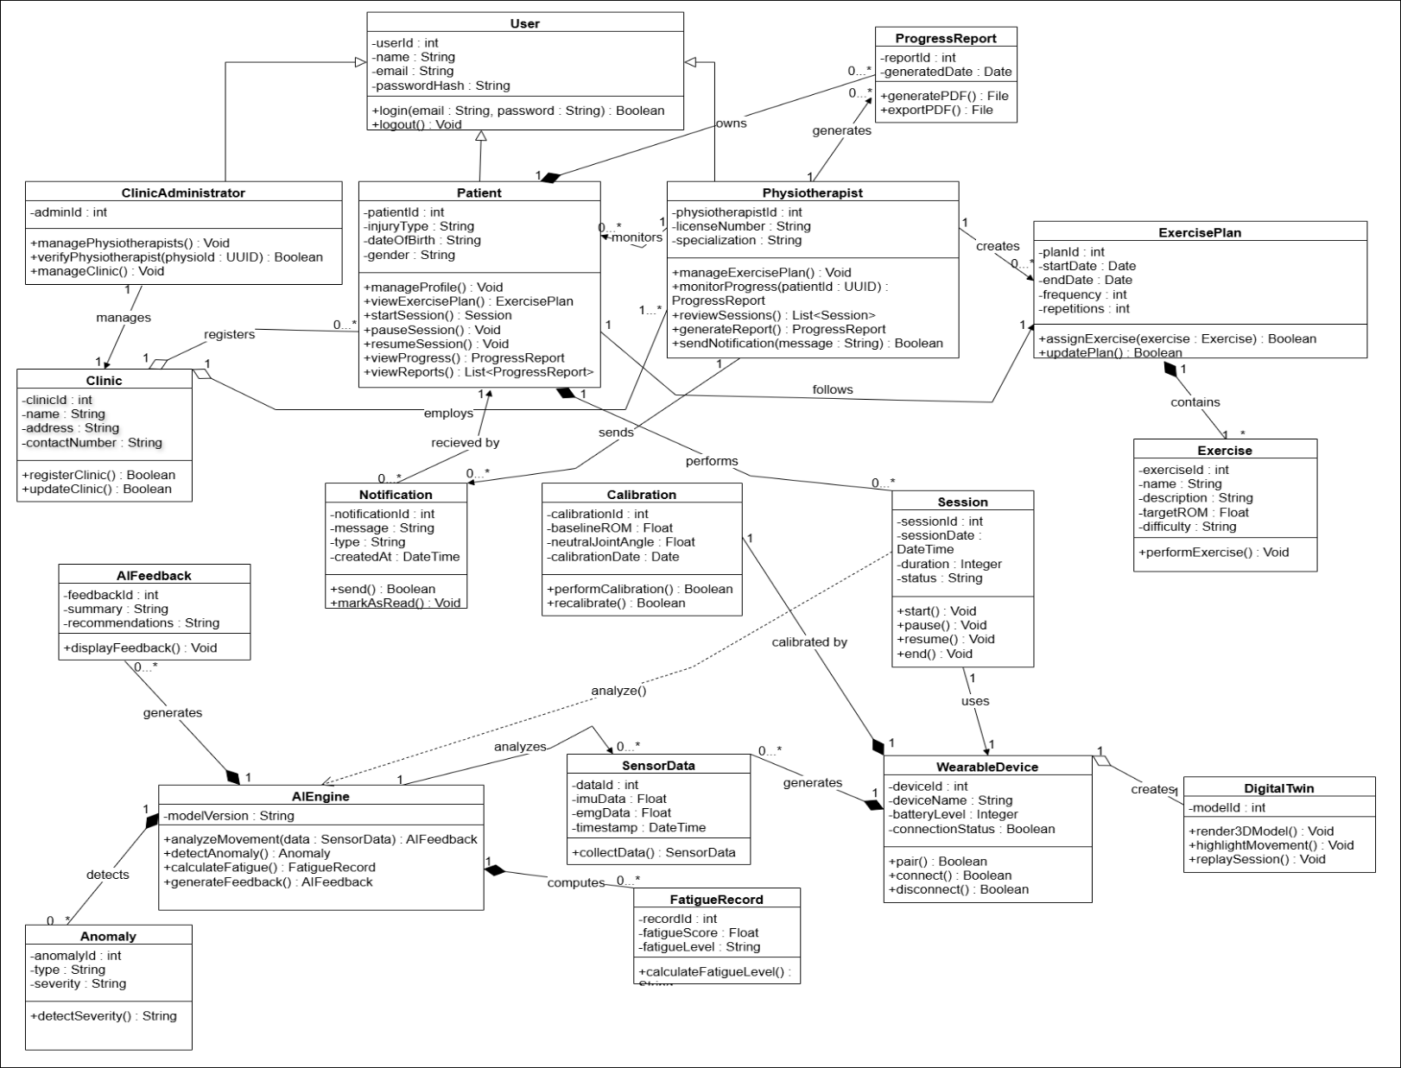
Class Diagram

Slide 24
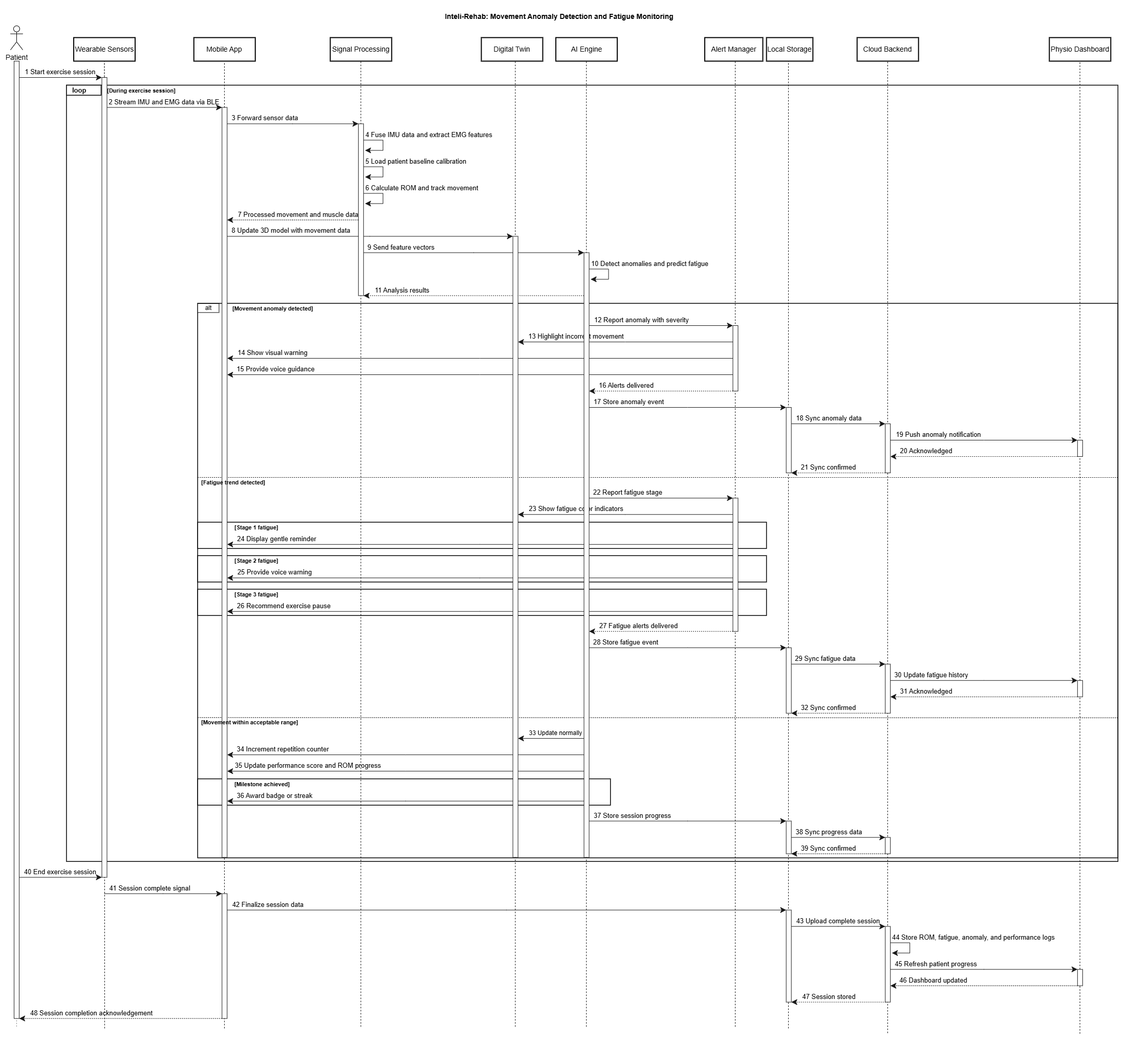
Sequence Diagram (Patient)

Slide 25
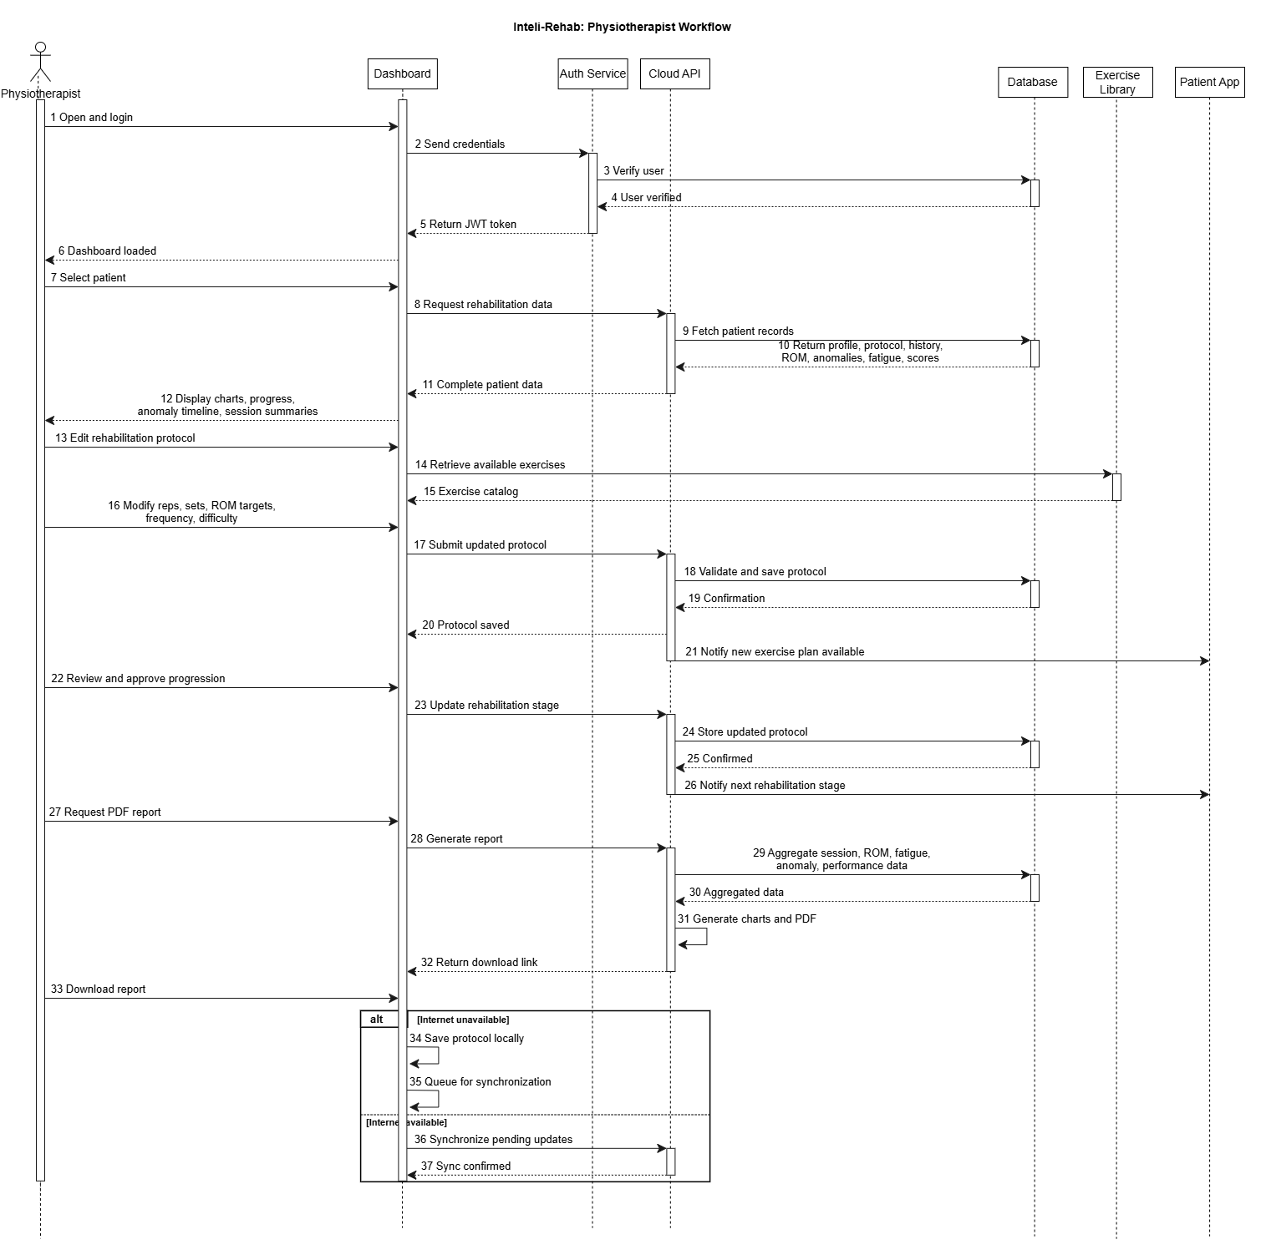
Sequence Diagram (Physiotherapist)

Slide 26
Sequence Diagram (Clinic)

Slide 27
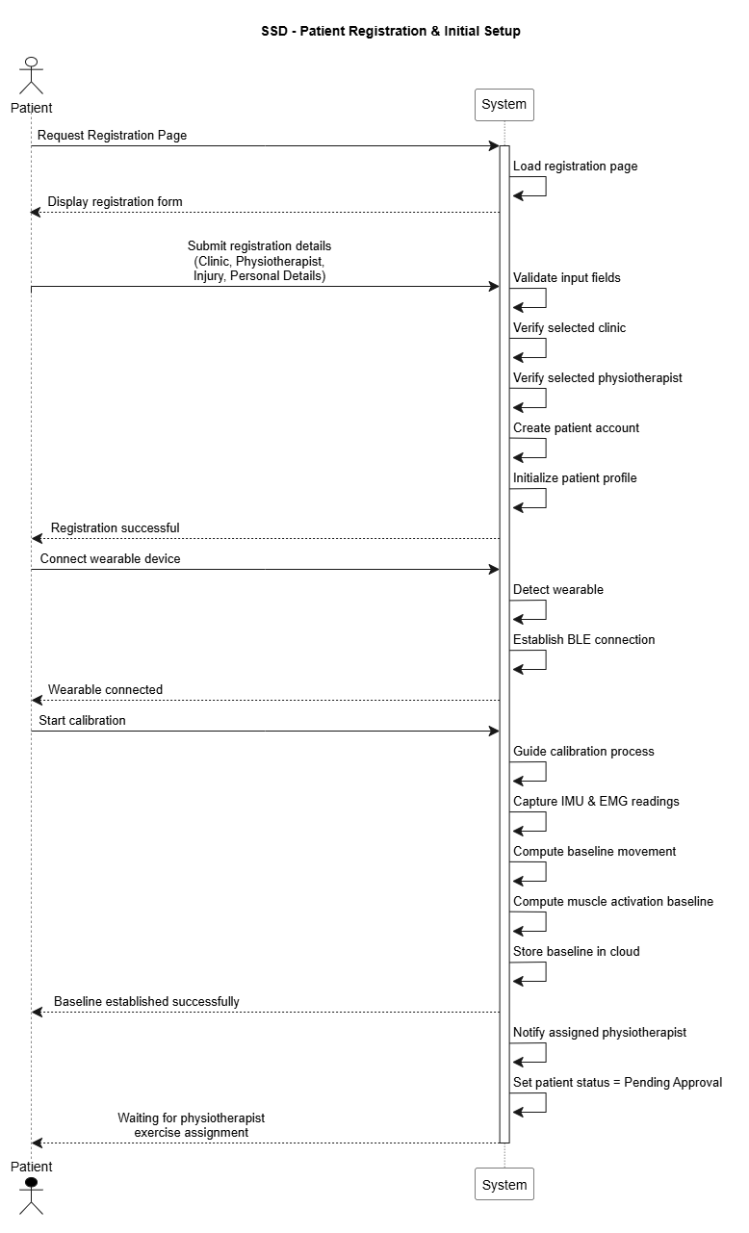
System Sequence (Patient Sign Up)

Slide 28
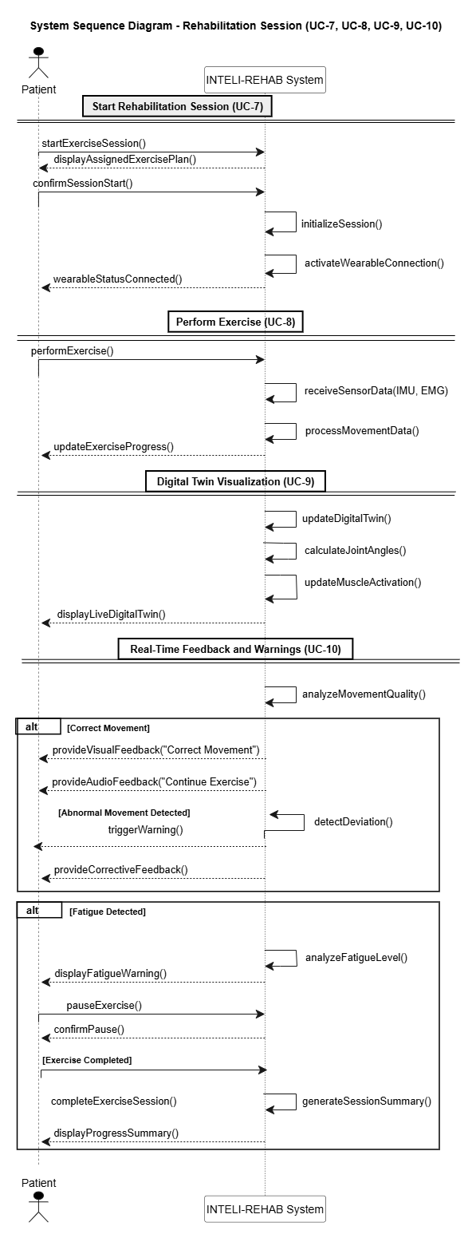
System Sequence (Rehabilitation Session)

Slide 29
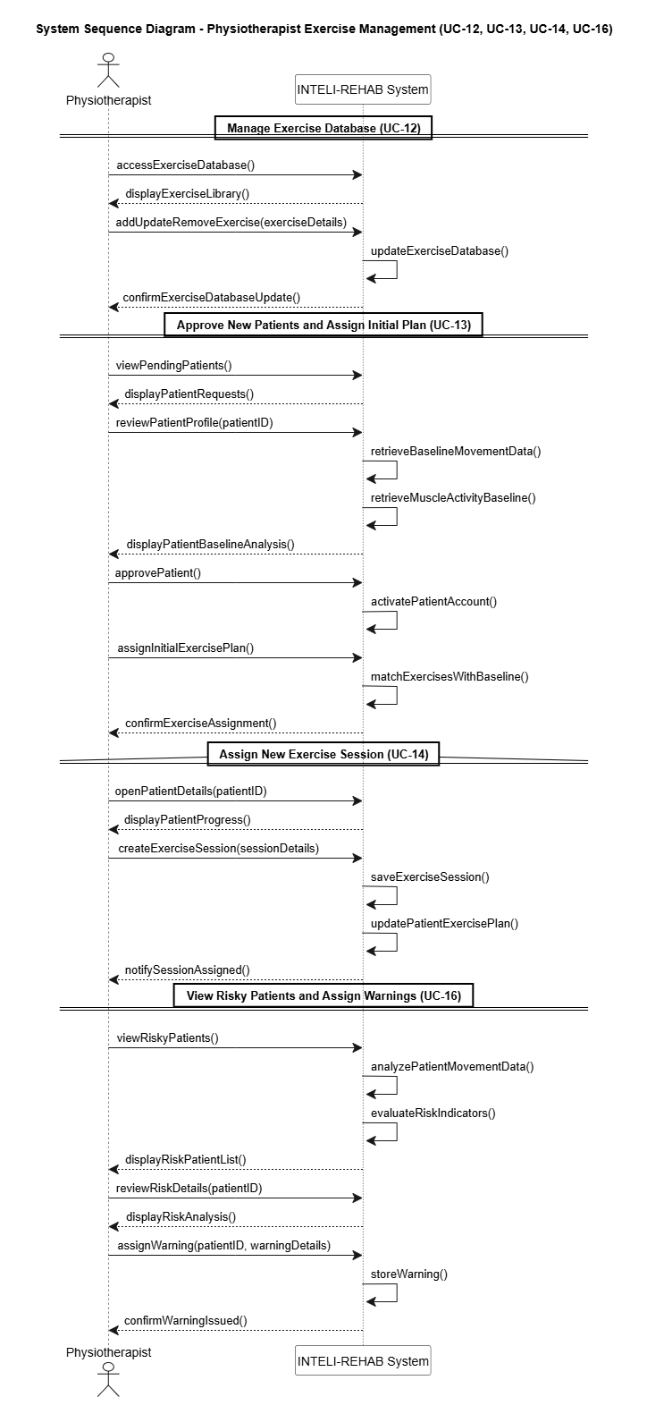
System Sequence (Physiotherapist Exercise Management)

Slide 30
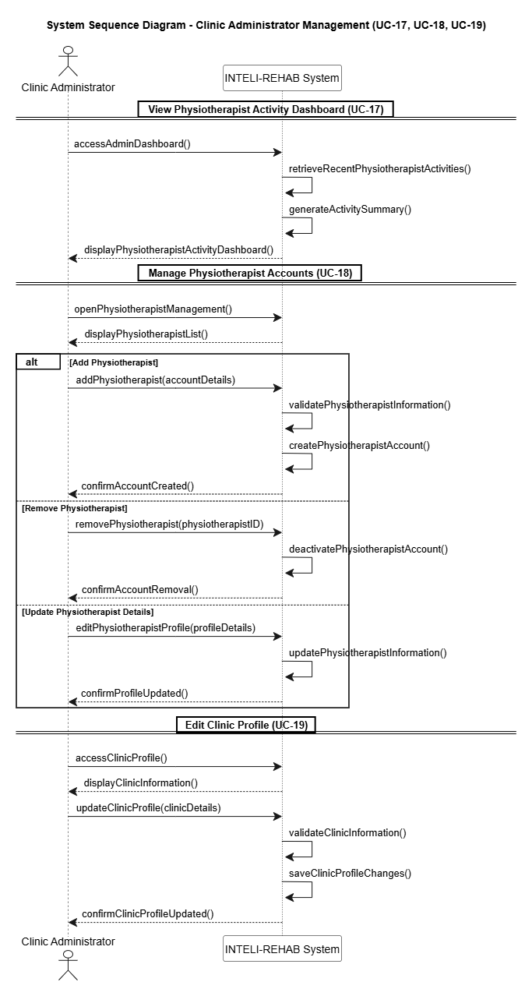
System Sequence (Clinic Administrator Management)

Slide 31
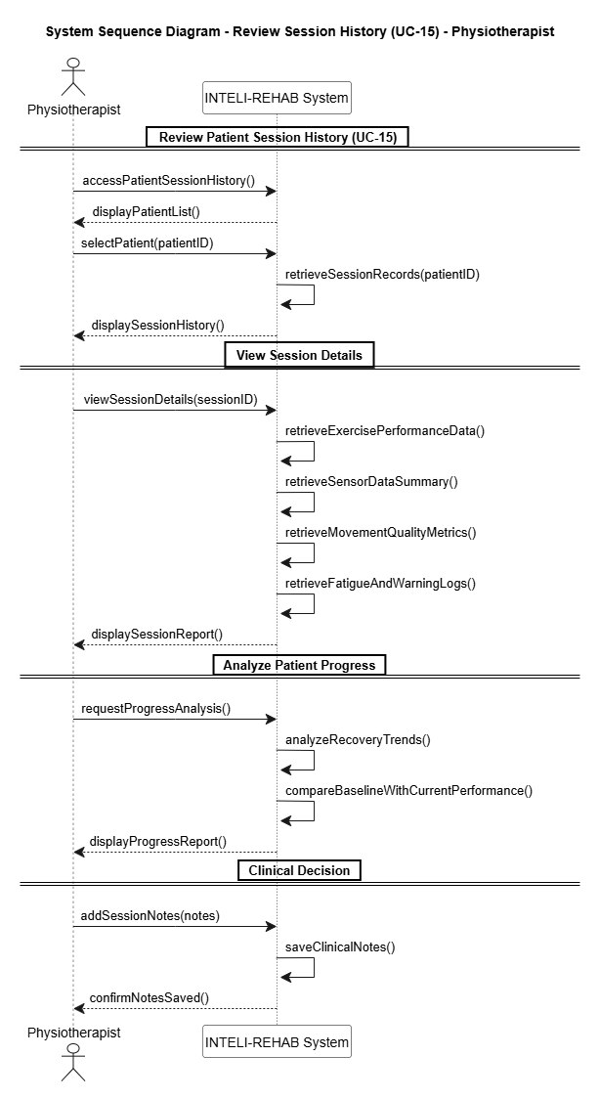
System Sequence (Review Session History)

Slide 32
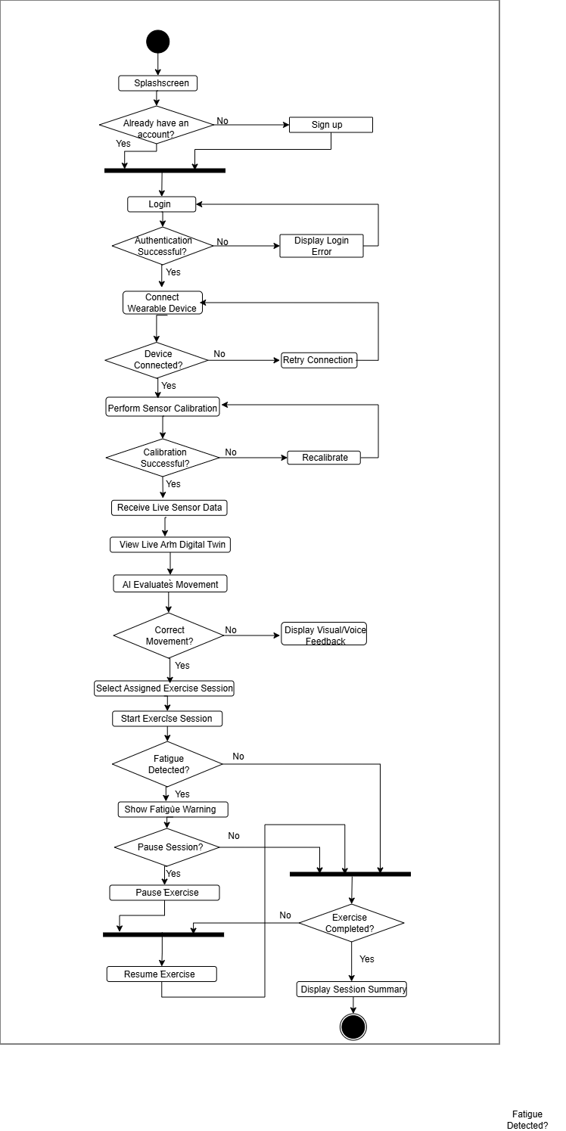
Activity Diagram (Patient)

Slide 33
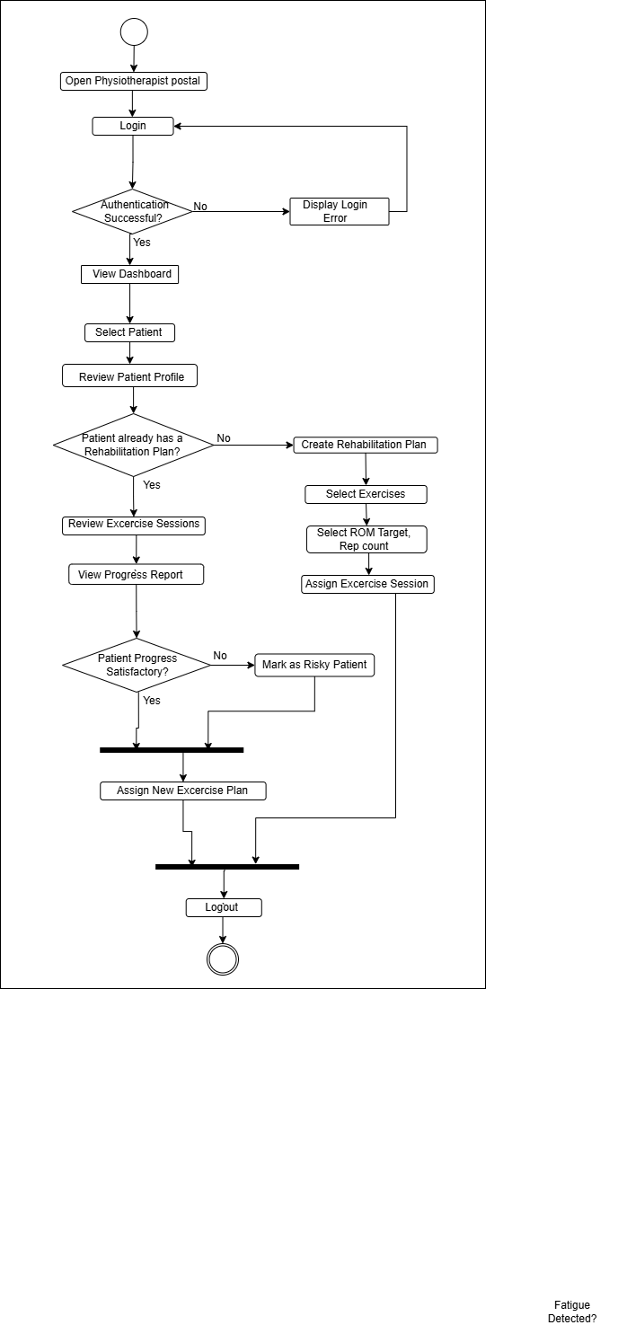
Activity Diagram (Physiotherapist)

Slide 34
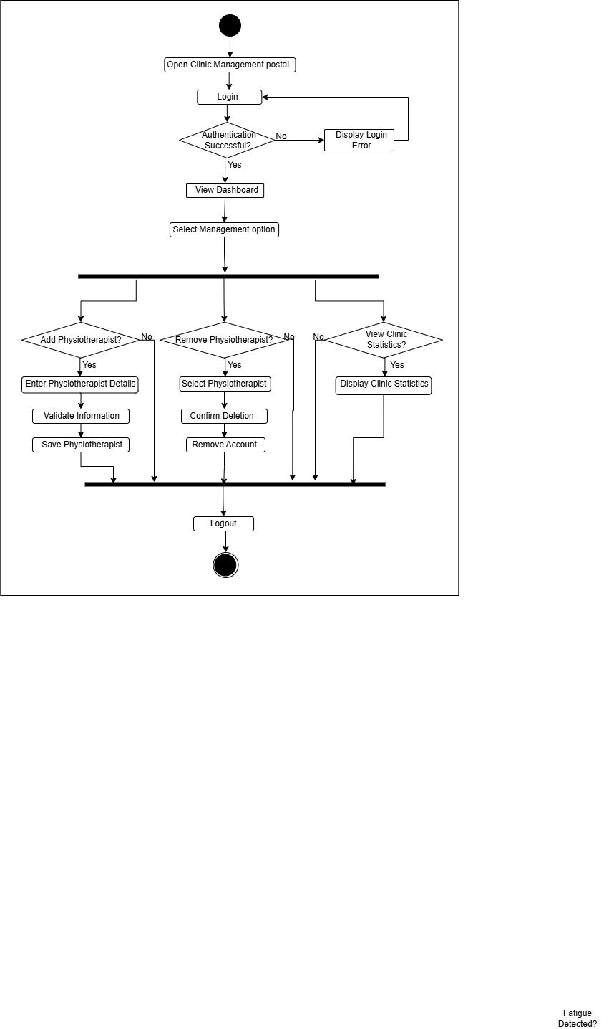
Activity Diagram (Clinic)

Slide 35
ER Diagram

Slide 36
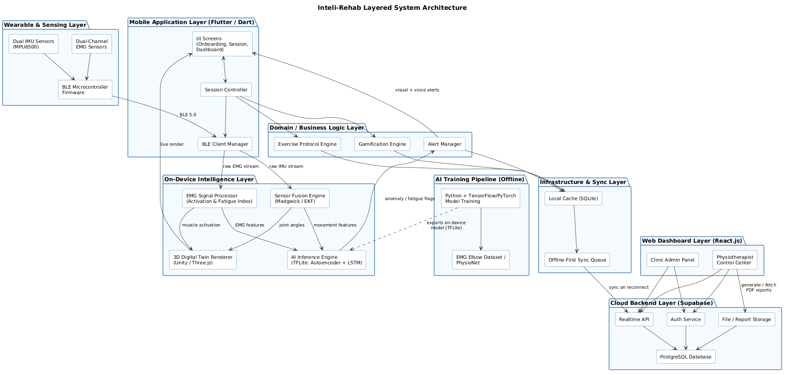
Architecture Diagram

Slide 37
Package Diagram

Slide 38
Deployment Diagram

Slide 39
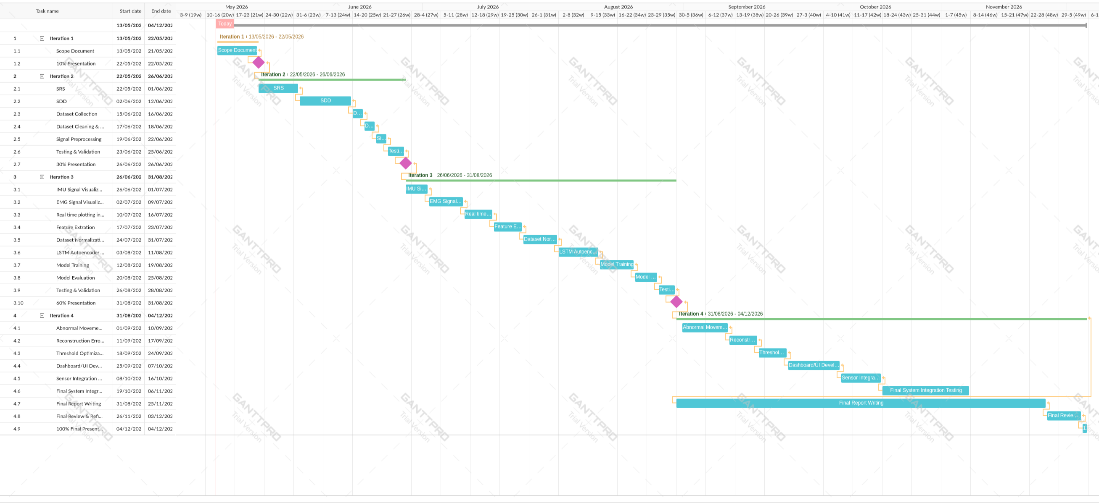
Gantt Chart

Slide 40
Details of 1st Iteration (30%)
Category | Completed Tasks | Status
Requirements Phase | Requirements Analysis & Review, SRS Document | Completed
Design Phase | System Architecture Design, SDD (Design Document) | Completed
Development Setup | Flutter + Supabase environment setup | Completed
Module Development | Patient / Physiotherapist / Clinic UI with authentication Wearable armband hardware prototype (ESP32 + IMU + EMG) | Completed
Milestone Deliverable | 30% Report + Presentation (10 Dec 2025) | Completed
2

Slide 41
Details of 2nd Iteration (60%)
Category | Planned Tasks | Status
Advanced Feature | Complete BLE wearable connectivity and sensor calibration pipeline | Completed
New Modules | Sensor Fusion Engine (joint angle & ROM) EMG Signal Processor (activation & fatigue) AI Inference Engine (anomaly + fatigue detection) 3D Digital Twin Renderer | Completed
Milestone Deliverable | 60% Report + Presentation (5 May 2026) | Pending
3

Slide 42
Conclusion
Inteli-Rehab addresses the critical need for accessible, sensor-based rehabilitation monitoring
Combines wearable IMU/EMG sensing with AI-powered movement and fatigue analysis
Digital Twin visualization improves patient engagement and movement correction
Modular, layered edge-cloud architecture ensures scalability and maintainability
Physiotherapist and clinic dashboards support informed, remote clinical decisions
Represents significant innovation in accessible, gamified rehabilitation technology
Foundation for future expansion into broader musculoskeletal rehabilitation care
THANK YOU!
4

